Slide 1
Drag and Weight
Past Paper Question 11 marks
Name: Date:

Slide 3
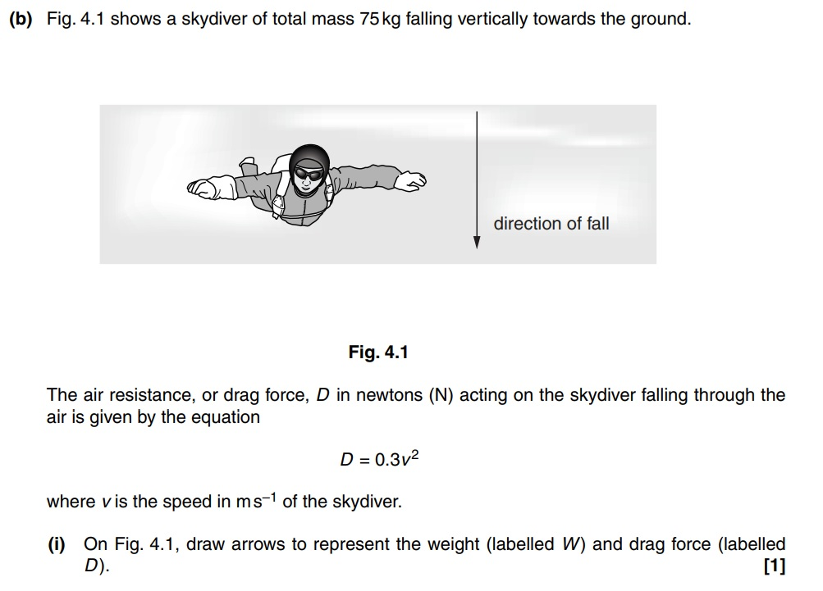
[2]

Slide 7
Drag and Weight
Past Paper Question 11 marks Answers
Name: Date: Class:

Slide 8
State
Surface area
Speed / Viscosity / Temperature / Density
[2]

Slide 9
D
W
draw
[2]
[2]

Slide 10
Calculate
W = m x g = 75 x 9.81 = 735.8
740
[1]

Slide 11
Calculate
D = 0.3 v² = 0.3 x 20² = 120 (N)
F_{net} = W – D = 735.8 – 120 = 615.8 (N)
F = m x a a = F / m = 615.8 / 75 = 8.21
8.2
[3]

Slide 12
State
W = D / Same magnitude
[1]
Determine
W = 0.3 x v² v² = 735.8 /0.3 = 2,452.7
v = 49.52
50
[2]

